Slide 1
CUSTOMER VALUE MODELING (CVM) -SCIENTIFIC ENTERPRISE SYSTEM
Manam Bharadwaj
2021MT13176
2021mt13176@wilp.bits-pilani.ac.in

Slide 2


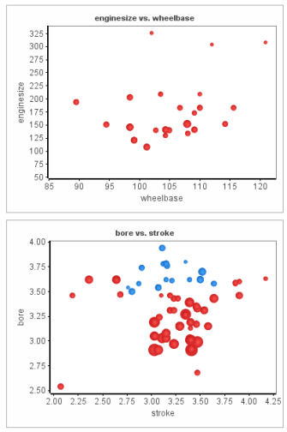
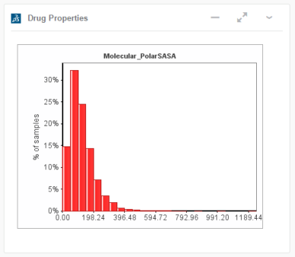

System and Goal
This project is about my workspace where we have developed a Scientific Modeling System in the field of biodiversity and material science.
The system works as robotic framework which leverage diverse data and then models it to reveal insights and flags related to future risks.
Goal of the system is to have an highly efficient presentation system sitting on large unutilized data, processing it with easy interface to users and then presenting a single simplified view at real time.
Dashboard Server
Dashboard Services
Generated Widget
Prod Server
Protocol execution HTML output page
Protocol execution request

Slide 3
Top3 Architecturally Significant Requirements (ASRs)
Availability - The system should be available to customers at all times so that predictive analysis links are never broken, which may cause huge business loss to the enterprise science labs.
Security - Data presented and in use is highly sensitive and users are required to be thoroughly validated against the SSO access services. This system may be used for strengthening or gathering information for publishing research as well. Any security breaches in such data would be liable to legal action which may tarnish brand value of the business along with financial penalty.
Performance - Application must be able to display widgets to the dashboard with user request placed, and widgets should be ale to handle large streams inflow. We need to keep in mind that certain pattern may be particularly chosen to achieve this quality attribute hence this is important for the system.

Slide 4
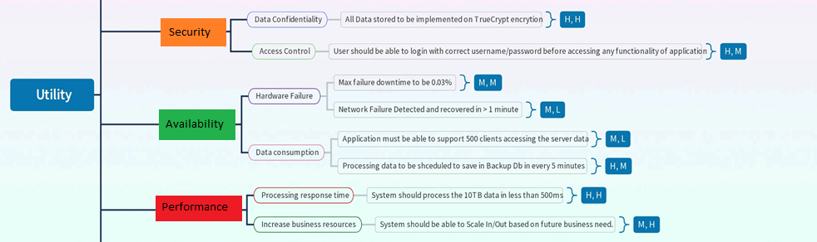
Utility Tree Diagram

Slide 5
Use Cases
Use Case | Description
UC-1: Monitor Online Services | On-duty operations staff can monitor the current state of services and IT infrastructure (such as web server load, user activities, and errors) through a real-time operational dashboard, which enables them to quickly react to issues.
UC-2: Troubleshoot online service issues | Operations, support engineers, and developers can do troubleshooting and root-cause analysis on the latest collected logs by searching log patterns and filtering log messages.
UC-3: Provide management reports | Corporate users, such as IT and product managers, can see historical information through predefined (static) reports in a corporate BI (business intelligence) tool, such as those showing system load over time, product usage, service level agreement (SLA) violations, and quality of releases.
UC-4: Support data analytics | Data scientists and analysts can do ad hoc data analysis through SQL-like queries to find specific data patterns and correlations to improve infrastructure capacity planning and customer satisfaction
UC-5: Anomaly detection | The operations team should be notified 24/7 about any unusual behavior of the system. To support this notification plan, the system shall implement real-time anomaly detection and alerting (future requirement).
UC-6: Provide security reports | Security analysts should be provided with the ability to investigate potential security and compliance issues by exploring audit log entries that include destination and source addresses, a time stamp, and user login information (future requirement).

Slide 6
Tactics used to achieve Top 3 ASRs
Availability
- Server fault detection system at place using heartbeat mechanism
- Rollback and System Monitor at place for fault recovery and fault detection (Zookeeper)
Machine 1
Active
heartbeat
Machine 2
Passive
failure
data
Zookeeper
machine
Zookeeper
machine
Machine 1
Active
Machine 2
Passive
Machine 3
Passive
data
Replica
data
Replica data

Slide 7
Tactics used to achieve Top 3 ASRs
Security:
Service Denial and Message detection at place via Load balancing systems
Attack resistance is at place through data encryption and actor authorization with data access limit. This includes HMAC encryption technique
System reboot and lock and availability check after restore is at place
Ongoing and automated inspection and monitoring of web applets and enable Kerberos network security protocols
Load Balancer
Load Balancer
Machine 1
Active
Machine 2
Active
Machine 3
Active
Other machines

Slide 8
Tactics used to achieve Top 3 ASRs
Performance:
Resource demand and management handled with DDM at place for caching and faster retrieval to achieve maximum performance
Extensive multithreading and background tasks are used for client application performance.
Performance dashboard indicating multiple metrics set for real time monitor of performance
Widget Runner and Widget Builder must not impose more than 2 seconds of overhead relative to execution of same protocol directly in browser.

Slide 9
Component and Connection Diagram
Authentication
Dashboard
Key
Widget
Intelligent
search
Widget Runner
Message
Bus
Authentication
Services
Compass
Interwidget
Comms
Deployment Unit
PPPR
1<>1
1<>1
1<>n
1<>1
Process
Protocol Search
Software Product
Core Application
Data Server
HTTP(S)
1<>1
Data
NAS
Web Server
App Server
Protocol
Services
Job
Services
XMLDB
Services
Storage
Services
Search/
Indexing
WS(S)
Authn
Services
REST
Services
SOAP
Services
Apache
Tomcat
1<>1
Cmd Line
Apache HTTPD
Named Pipes
1<>1
Mem Map File
Run-Time Server
XMLDB
scisvr
User Data
Block Storage
1<>n
Job Data

Slide 10
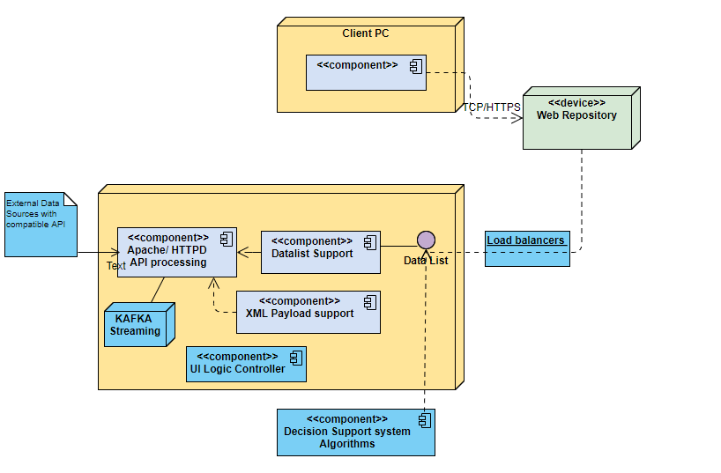
Deployment Diagram
Application Server
Dashboard

Slide 11
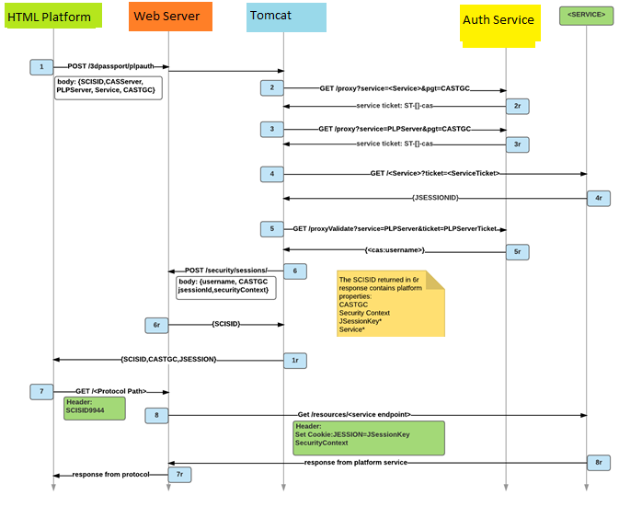
Sequence Diagram for Security Scenario: Access Control and authentication services

Slide 12
Security Scenario: Access Control and authentication services
User can initiate the login and loading process which then triggers through Security and Authentication process respectively.
User tries Dashboard Login
Authenticator Server -Returns CASTGC cookie for session
Widget then Send a “CAS Login” request to the Authenticator Server.
Authenticator Return JSON Object, with Service Ticket Id
Widget then Send Authenticator Server URL and Service Ticket to the Application Server.
Application Server then Authenticate Service Ticket by checking with Authenticator messaging.
Get Services sessions request send to Authenticator.
Gets back Add returned JSessionIds to Application Session.
Application server then Return Session ID (SciSID) to Widget
Widget requests protocol execution (application running), passing through SciSID received in previous step.
Widget protocol exchanges data with other services using JSessionIds
Result page returned to Widget Viewer
HTML Dashboard
Widget Builder View
10
12
9
Application Server
1
2
3
4
5
6
Authenticator server
7
8
11
Other services in company

Slide 13
Patterns Used:
A) Client Server Pattern
Dashboard Application
Navigation Compass
Intelligent Search
Dashboard Widget
Client
Tool Bar Menu
Message Bus
Application Pilot Server
Dashboard Server
Core Protocol Services
Compass Services
Intelligent Search Services
Widget Runner Services
Server
Locator Service
XMLDB Service
Runner Service
File Service
Protocol REST / SOAP
Scientific Services
Modelers
Protocol Runtime Environment
Content Access Services / Management
General Admin Services
Widget Server
Authentication Server
Access Right
Configuration
Widget DB
Authentication Services
• Used to provide data/management services to all stakeholders as described earlier in the views.
• For management operations CLI/GUI resides on client desktop/laptop systems and REST web server is on widgets.
• For Data operations, clients from distributed hosts would be requesting services from protocol server.
• Client calls are made on Bidirectional-Asynchronous Message communication pattern

Slide 14
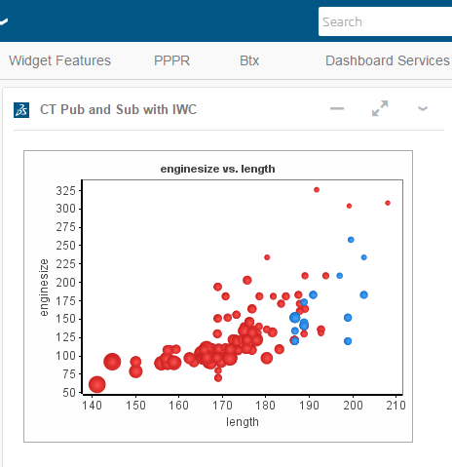
Patterns Used:
B) Publish-Subscribe Pattern: Bidirectionality
Widgets using ‘explicit tagging’ (Tagging where all tag info is passed to Tagger on Widget init server) can set UI elements connected to the Data Connector to ‘Publish and Subscribe’.
In this case user selections will be converted into new Tags (Category: User Selections) named ‘Selection n’ which can then be used by the Tagger system like any other Tag.
Actions:
Create and view multiple Selections
Union with other User Selections
Intersect with other Tags

Slide 15
How System Works
System is working as Client Server Architecture
There are two type of Clients which communicate with a central server
All sort of Client and Server communication happens through central server through TCP/IP.
Data Visualization Stream happened with a socket implemented on server
Both clients have implementation of Algorithm applets and Logic controller which can be shared through a central server.
Communication between Client and Server happens with REST/SOAP services and Socket connection
Server follows the Micro services Architecture to provide REST APIs and Socket Connections
System connects to external data sources via an extensive library of APIs
Creates and combines interactive charts and visuals for key stakeholders Fully HTML 5 compliant.
Graphs include: Scatter plot, Line Plots, Pie Charts, Bar Plots, Histograms, Polar Plots and Interactive tables with sorting, search.

Slide 16
Key Learnings
Learnt to handle following challenges in architectural planning and design phase.
What is the time available for the architectural analysis/evaluation? It is challenging enough to come up with one solution, let alone a few!
What is the product pipeline for the next 1–3 years? And what other projects are lined up? Can we see any synergies?
What is system current technical debt that we could potentially address?
Learnt to handle following technical, high level and low level design aspects of architecture planning
Such system require must plan for ASRs and NFRs at architectural planning level.
The SOLID principles just do not only apply on software development but also when architecting a system
Client system is live for an hour at a time so error handlings (Network, Hardware issues) must be at its best and well designed
Patterns involved in the system as different type of users using a complex UI.
System availability and performance is most important concern and must be handled properly as system needs to be available throughout the year.
Component connections can not be easily modifiable so must be planned before hand in architecture.
Learnt to understand different architectural patterns used to fulfill requirement goals.
C&C, deployment diagrams, sequence diagrams are very useful to get clarity on the environment, elements and their interaction, visualize the flow or interdependencies and end result in an early stage.
Architectural documentation helps new team members/stakeholders to quickly ramp-up and have confidence in the overall product.

Slide 17
THANK YOU

